Slide 1

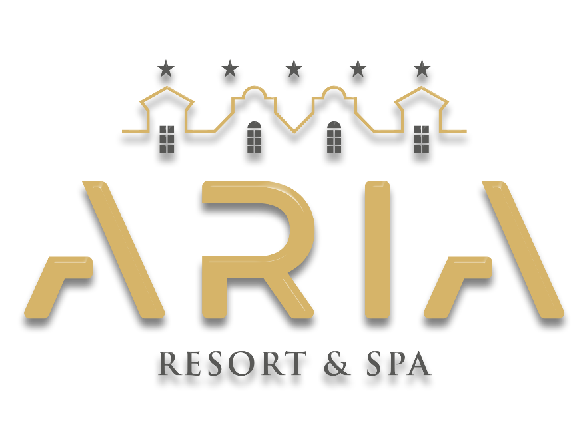
SUSTAINABILITY
MANUAL
2025

Slide 2
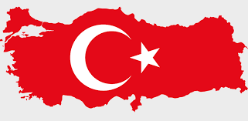
REPUBLIC OF TURKEY
THE FOUNDING OF THE REPUBLIC OF TURKEY
After the National War of Independence, which began on May 19, 1919, the First Grand National Assembly of Turkey convened on April 23, 1920, under the leadership of Mustafa Kemal Atatürk.
With the adoption of the first constitution on January 20, 1921, "Sovereignty unconditionally belongs to the nation. Executive and legislative authority is vested in the Grand National Assembly of Turkey on behalf of the Turkish nation."
On April 23, 1921, on the first anniversary of the opening of the Grand National Assembly, April 23 was declared a national holiday by Law No. 112.
The Republic was proclaimed on October 29, 1923.

Slide 3
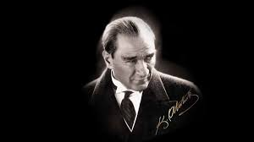
MUSTAFA KEMAL ATATÜRK (1881-193∞)
FOUNDER AND FIRST PRESIDENT OF THE REPUBLIC OF TURKEY – ATATÜRK
He was born in Thessaloniki in 1881. His mother was Zübeyde Hanım and his father was Ali Rıza Efendi. He attended various schools including the Neighborhood School, Şemsi Efendi School, Thessaloniki Civil Service Secondary School, Thessaloniki Military Secondary School, Thessaloniki Military High School, War Academy and Staff College. In 1893, while studying at the Military Secondary School, his mathematics teacher added "Kemal" to his name, and he became known as Mustafa Kemal.
When the Ottoman Empire was defeated in World War I, the Armistice of Mudros was signed. As the occupation of the homeland began under this armistice, Mustafa Kemal arrived in Samsun on May 19, 1919, and launched the national struggle.
Mustafa Kemal was elected as the Speaker of the Assembly and Head of Government with the opening of the Grand National Assembly on April 23, 1920. After the victory in the Battle of Sakarya, he was honored with the title of Ghazi and the rank of Marshal. With the proclamation of the Republic on October 29, 1923, Mustafa Kemal became the first President of the Republic of Turkey.

Slide 4
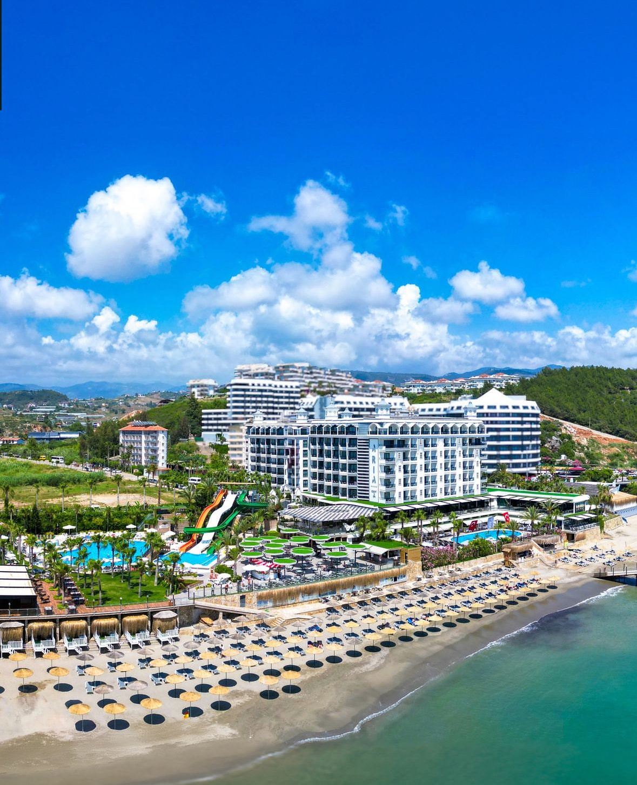
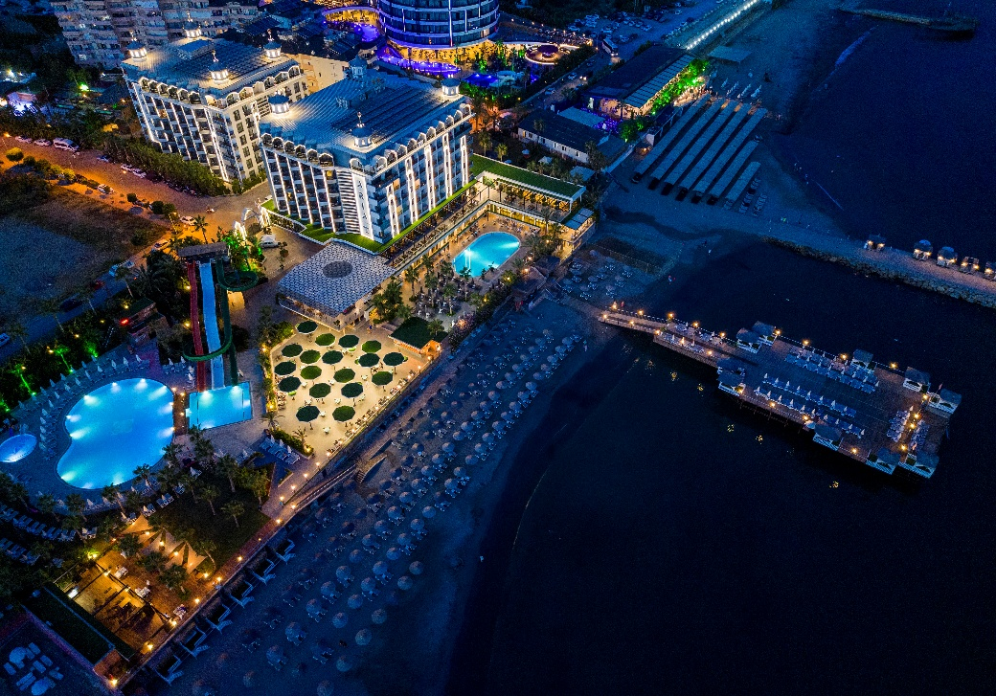
ARIA RESORT & SPA HOTEL
ARIA RESORT & SPA HOTEL initiated its sustainability efforts as of 2023. This sustainability report contains data for the year 2025.
Our goal is to maintain the highest level of guest satisfaction by providing the best quality service together with all our team members, in accordance with legal requirements. In this direction, we aim to share the progress we have made in sustainability with our management, team members, guests, suppliers, and all other partners, thereby increasing awareness of sustainability and achieving the targets we have set.
We develop our goals in line with the principle of continuous improvement, taking into account today's changing conditions and being aware of the responsibilities that sustainable tourism brings. We continue our efforts to ensure the most efficient use, protection, and transfer of our resources to future generations.
In this regard;
By raising awareness of sustainability,
By supporting local development and the local economy,
By ensuring local employment without discrimination on issues such as gender inequality, race, and special and vulnerable groups,
By conducting social activities both within the facility and together with the local community,
By increasing the awareness of our natural, cultural, and historical values,
By maintaining guest satisfaction at the highest level,
We apply sustainable tourism principles by using our resources efficiently and working to reduce environmental impacts.
We are aware of our responsibilities toward nature. Therefore, we carry out certain activities at our facility in line with sustainable tourism principles.

Slide 5
OUR QUALITY AND SUSTAINABILITY POLICY
ARIA RESORT & SPA HOTEL
By implementing the Integrated Management System, which we have established and documented in the fields of quality, food and water safety, occupational health and safety, information security, infectious disease management, and sustainable tourism, prioritizing social, environmental, and cultural values within the framework of local and international laws and standards, and providing the necessary resources to implement pioneering structures in the tourism sector;
To comply with all applicable legal regulations, national and international standards, and all conformity obligations related to our activities,
To ensure continuous improvement by basing stakeholder satisfaction on all our activities, evaluating our internal and external issues, the needs and expectations of our interested parties, and analyzing potential risks and the opportunities arising from those risks in advance,
To determine objectives, risks, opportunities, and threats, to create means for our employees, guests, local community, and all stakeholders to communicate their needs, requests, suggestions, and complaints, and to monitor and measure system performance and the effectiveness of applications with a stakeholder-focused approach,
To organize the necessary training to increase the awareness and competencies of our employees, who are selected from the local community as much as possible, to provide incentives, motivation, and proper communication, and to ensure the participation of our employees, including their suggestions, in all our activities,
To provide a safe and healthy working and living environment for our employees, guests, and all stakeholders; to establish and effectively implement an organization capable of responding to emergencies in the shortest time and most effective manner, with the aim of preventing accidents and occupational diseases,
To provide a safe and healthy working and living environment for our employees, guests, and all stakeholders; to establish and effectively implement an organization capable of responding to emergencies in the shortest time and most effective manner, with the aim of preventing all illnesses that may arise from food, water, and infection sources,
To protect the confidentiality, integrity, and accessibility of information and to ensure the personal information security of our employees, guests, and stakeholders,
To provide environments at our facilities that contribute to children's development, where they can freely express their thoughts, wishes, and emotions, and feel free and comfortable under parental supervision; to oppose all actions that may leave psychological and physical effects on all individuals, especially children, women, and persons with limited mobility, and that may restrict their rights, and to share this awareness with all our employees and stakeholders, and to combat such actions within the framework of the law,

Slide 6
OUR QUALITY AND SUSTAINABILITY POLICY
ARIA RESORT & SPA HOTEL
To make the necessary arrangements at our facilities so that our employees and guests with limited mobility can safely and fully benefit from and access all amenities and environments,
To ensure women's participation in the workforce by providing a working and living environment that maintains work/family life balance, without gender discrimination, in accordance with the principle of equality, and by preventing the restriction of their rights,
When planning our investments and activities, to consider the impacts on protected sensitive areas, historical heritage, and the integrity of the natural and cultural environment; to use natural resources efficiently and economically, and to prefer plants, practices, and materials suitable for the region/ecosystem in our landscaping work,
To analyze our philosophy of producing as much energy as we consume; by using energy-efficient devices and methods suitable for today's conditions to reduce our carbon footprint in energy and natural resource usage that causes climate change, by investing and planning to reduce energy and natural resource consumption in our activities, and by measuring and analyzing consumption,
To ensure that prohibited/endangered species of animals and plants that threaten natural life will not be kept in our activities and facilities, and that the necessary notifications will be made directly to legal authorities if detected,
To contribute to the preservation, development, and promotion of local/regional foods, areas, and traditions of historical, archaeological, cultural, and spiritual importance in our country and region,
To evaluate the quality and specifications of all products and materials we procure with users, analyze their suitability within our activities, and audit the persons/companies we procure from; to keep the harmful effects on the environment, natural life, ecosystem, and human and living health at the lowest possible level, and to procure from local producers or fair suppliers with less packaging and a lower carbon footprint, within the legal framework,
At our facilities, within the scope of the "Zero Waste" project, we commit to providing information and awareness for the correct and proper separation of waste, preferring recyclable materials, effectively ensuring the separation of generated waste, ensuring the disposal of non-recyclable materials by authorized organizations, and reducing the amount of waste by keeping the use of disposable materials at the lowest possible level.

Slide 7
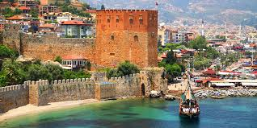
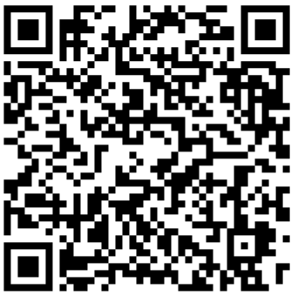
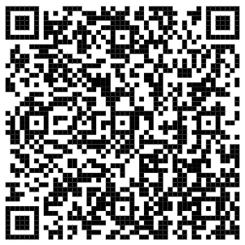
MAP AND ROUTES
Scan the QR code for Konakli bus routes and schedules.
Scan the QR code for Alanya bus routes and schedules.
From our hotel;
Alanya Castle 16 km
Alanya Red Tower 14 km
Alanya Cable Car 12 km
Alanya Cleopatra Beach 13 km
Damlatas Cave 12 km
Dim River 16 km
Syedra Ancient City 35 km
Sapadere Canyon 59 km
Manavgat Waterfall 53 km
Side Ancient City 55 km
Aspendos Ancient Theater 84 km
Antalya Old Town (Kaleici) 129 km

Slide 8
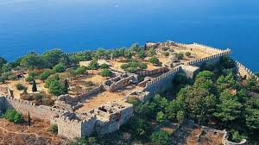
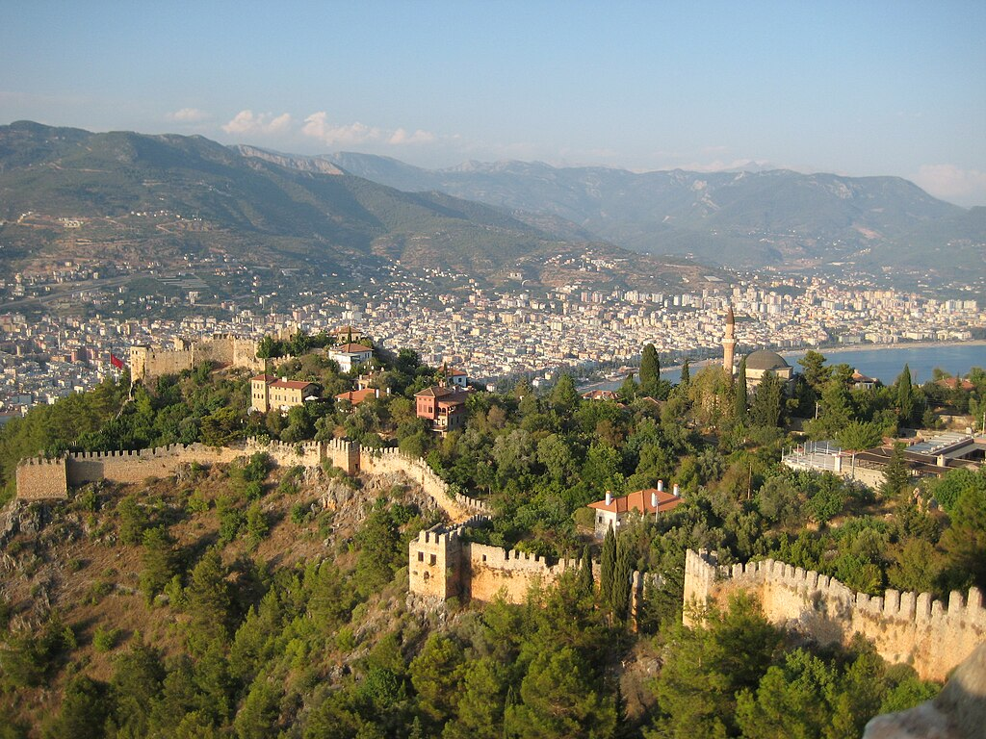
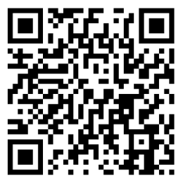
ALANYA CASTLE
Alanya Castle is one of the landmarks of Alanya, a district of Antalya. It is situated on a peninsula rising approximately 250 meters above sea level. The total length of its walls is 6.5 kilometers. The castle was built during the Hellenistic period in the settlement of Alanya, which was formerly known as Kandeleri. Its current historical character dates back to the 13th century as a Seljuk structure, though its history extends to the Hellenistic period. The castle was built by Seljuk Sultan Alaeddin Keykubad I, who captured and rebuilt the city in 1221. The castle has a total of 83 towers and 140 bastions. In the Middle Ages, approximately 1,200 cisterns were built to supply the water needs of the city within the walls. Some of the cisterns are still in use. The walls were systematically constructed to pass through Ehmedek, the Inner Castle, Adam Atacagi, Cilvarda Cape, Arab Evliyasi, and Esat Bastion, then through Tophane and the Shipyard, ending at the Red Tower.

Slide 9
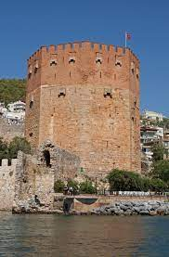
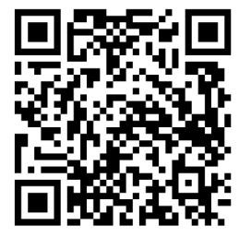
ALANYA RED TOWER
The Red Tower (Kizilkule) is a historic tower located in the city of Alanya, Turkey. The structure is considered the symbol of the city and is featured on the city's flag.
Construction began during the early reign of Anatolian Seljuk Sultan Alaeddin Keykubad I and was completed in 1226. The Sultan brought the master architect Abu Ali Reha from Aleppo, Syria to Alanya to complete the building. The octagonal red brick tower protects the Shipyard dating from 1221. Its name comes from the reddish-colored bricks used in its construction. It remains one of the finest examples of medieval military architecture and is the best-preserved Seljuk building in the city.

Slide 10
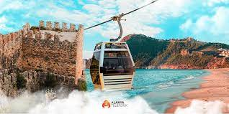
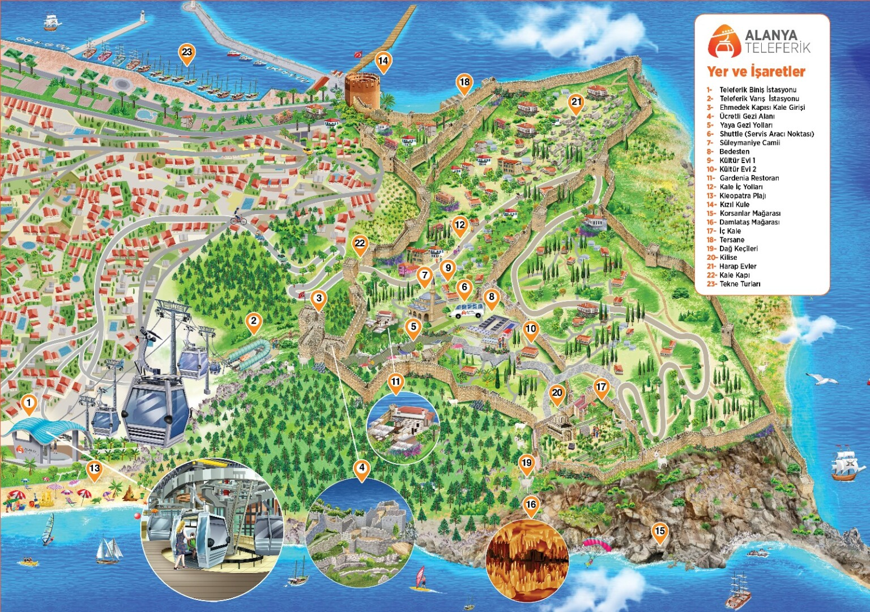
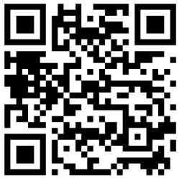
ALANYA CABLE CAR
The Alanya Cable Car offers "eco-friendly transportation" with its technology elegantly integrated into nature. Great care is taken at every stage of its construction and operation to protect the environment and use natural resources wisely. It encompasses all the advantages of ecological transportation vehicles. Designed to operate in all weather conditions, the Alanya Cable Car system can continue to work without interruption in conditions such as rain, wind, and high temperatures.

Slide 11
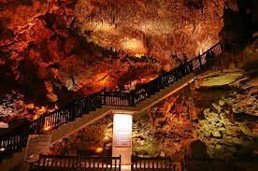
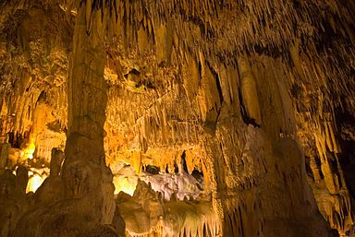
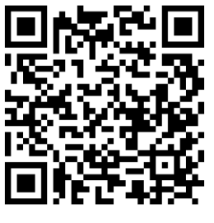
DAMLATAS CAVE
Damlatas Cave is a seaside cave in the Alanya district of Antalya. It is located 3 km from the city center of Alanya, on the western coast of the historic Alanya Castle. The cave takes its name "Damlatas" (dripping stone) from the water droplets that continue to drip from the stalactites. It was discovered in 1948 following a dynamite blast at a quarry site identified for use in harbor construction. Adorned with thousands of beautiful stalactites and stalagmites, the cave was immediately placed under protection, research began, and it was opened to tourism. Damlatas Cave is the first cave in Turkey to be opened to tourism.

Slide 12
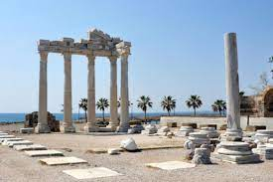
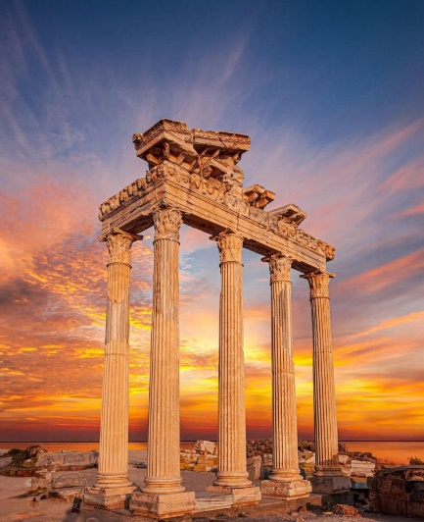
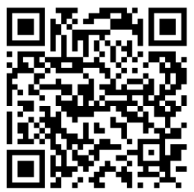
MANAVGAT SIDE
The ancient city of Side, founded in the 7th century BC, is among the most important historical settlements. This ancient city, belonging to the Pamphylia region, first came under the Lydian Kingdom and remained under this rule for many years. The ancient city of Side later passed to the Persian Kingdom, and with Alexander the Great's desire for the region, it came under the King of Macedonia.

Slide 13
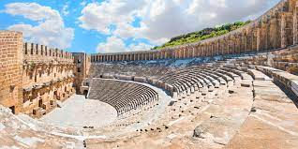
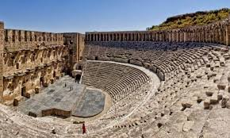
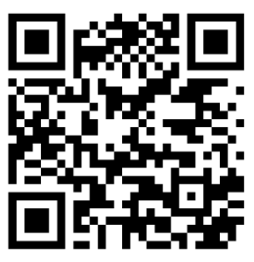
ASPENDOS ANCIENT THEATER
Aspendos is an ancient city famous for its ancient theater, located in the village of Belkis in the Serik district of Antalya. Aspendos is known for hosting the Aspendos Roman Theater, the best-preserved theater of the ancient world. The most important structure of Aspendos is its theater. It is an open-air theater that has been preserved in the best condition among ancient theaters. This theater is the oldest and most intact example of a Roman theater in Anatolia that has survived with its stage to the present day. Its architect was Zenon, son of Theodorus from Aspendos.

Slide 14
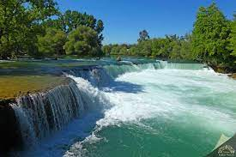
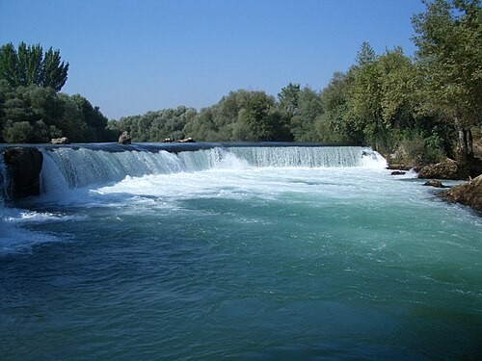
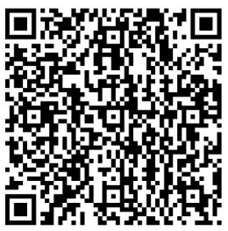
MANAVGAT WATERFALL
Manavgat Waterfall is a waterfall located on the Manavgat River in the Manavgat district of Antalya. Despite falling from a low height, it flows with a high discharge rate over a wide area. Around the Manavgat Waterfall, there are picnic areas for the public and properties operating as live fish restaurants within tourist facilities. By Presidential decree dated March 15, 2023, following the evaluation of the conservation status of the Potential Natural Site Area, the designated area was registered and declared as a Strictly Protected Sensitive Area.

Slide 15
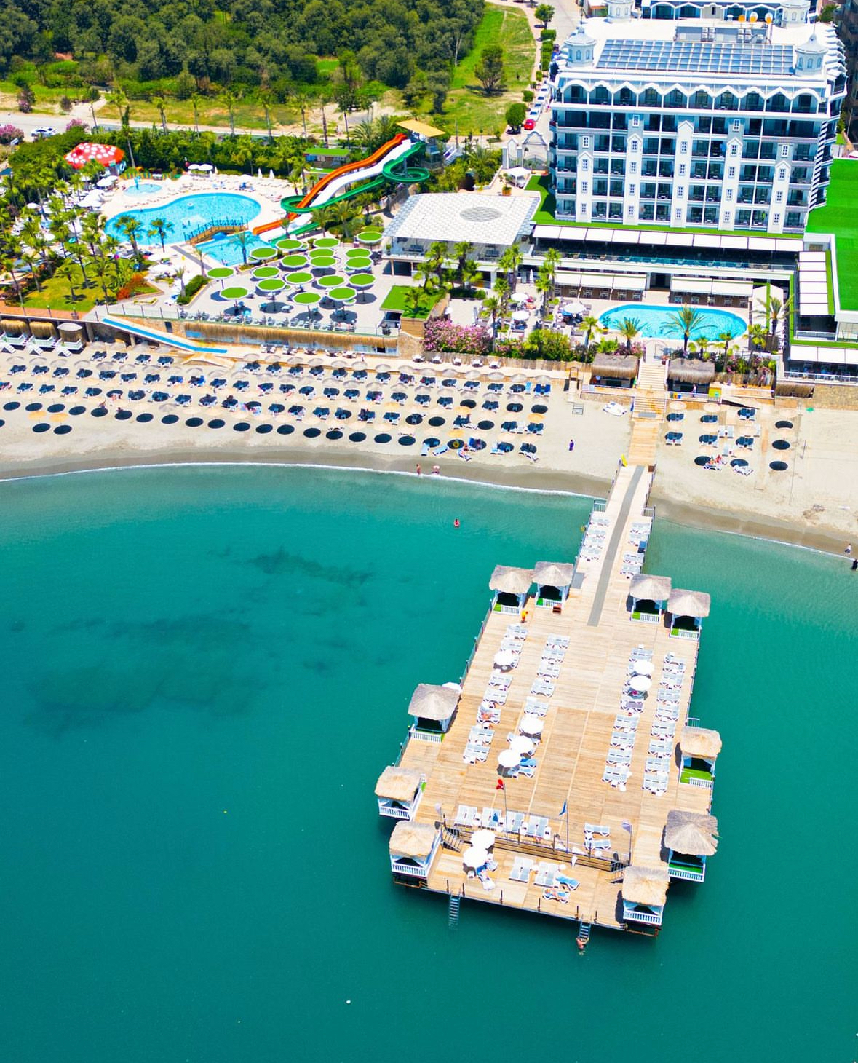

HOW TO GET THERE?
ALANYA CASTLE
Take the Konakli buses passing in front of our hotel and get off at Alanya city center. You can reach the castle by buses going to the Castle or by cable car from Damlatas.
ALANYA PIER – RED TOWER
Take the Konakli buses passing in front of our hotel and get off at Alanya city center. You can reach the pier by buses going to the pier.
MANAVGAT - SIDE
You can reach Manavgat and Side center in 1.5 hours by Antalya buses passing on the main road in front of our hotel.
ANTALYA
Take the buses from the main road in front of our hotel to the bus terminal. Antalya buses can reach Antalya center in 2.5 hours.
ANTALYA – GAZIPASA AIRPORT
Our hotel guests can reach Antalya Airport in 2 hours with their agency's transfer vehicles.
Our hotel guests can reach Gazipasa Airport in 1 hour with their agency's transfer vehicles.
ALANYUM SHOPPING CENTER
Take the Konakli buses passing in front of our hotel and get off at Alanya city center. You can reach the Alanyum shopping center by buses going there.
*** Public transportation in residential areas is provided by Supervised City Minibuses for a fee or by Municipal Buses using city cards.
*** Our guests may also use the taxi service from the taxi stands located near our hotel.

Slide 16
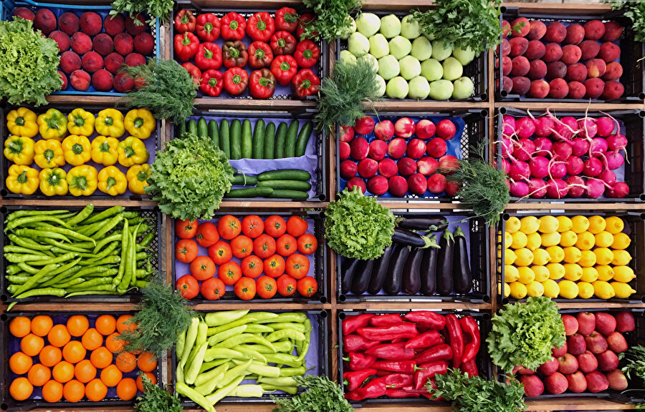
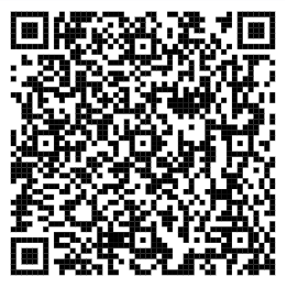
LOCAL MARKETS
KONAKLI MARKET IS SET UP EVERY WEDNESDAY NEXT TO KONAKLI MEDICAL CENTER.
The Konakli market can be reached by Konakli buses passing in front of our hotel. Other local markets in Alanya can also be reached in the same way.
ALANYA LOCAL MARKETS
You can get detailed information about other local markets in Alanya by scanning the QR code.

Slide 17
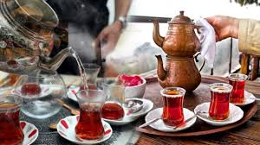
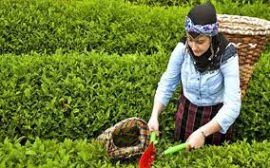
CULTURAL INFORMATION
TURKISH TEA
A type of black tea is produced in Turkey, grown on the eastern Black Sea coast. This type of tea is commonly known as Turkish tea. It is brewed with finely roasted black tea powder and served in distinctive small glasses known as "ince belli" (slim-waisted).

Slide 18

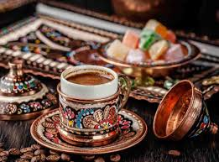
TURKISH COFFEE
Turkish coffee is one of the oldest coffee preparation and brewing methods, dating back to the Ottoman Empire, which holds an important place in Turkish culture. It has a unique identity and tradition with its distinctive taste, foam, aroma, and presentation style. It is the only type of coffee served with its grounds.
As of 2013, Turkish coffee culture and tradition has been inscribed on UNESCO's Representative List of the Intangible Cultural Heritage of Humanity on behalf of our country.

Slide 19
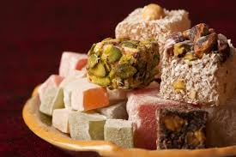
TURKISH DELIGHT
Lokum (Turkish Delight) is a traditional Turkish confection. Although it has been known in Anatolia since approximately the 15th century, it became particularly widespread within the borders of the Ottoman Empire in the 17th century. In Europe, it became known as "Turkish Delight" through an English traveler in the 18th century. Previously made with a combination of honey or molasses and flour, the production and flavor of lokum changed in the 17th century with the discovery and introduction of refined sugar, known as "Kelle sekeri," and especially starch.

Slide 20
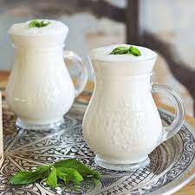
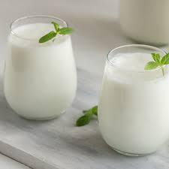
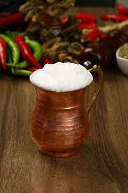
AYRAN
Ayran is a type of beverage made by adding water to yogurt. It is one of the most common beverages in Turkish cuisine.
The Gokturks, who ruled between 552-745 AD, added water to souring yogurt to reduce its sourness. Thus, ayran was accidentally created.
The word "ayran" was first defined in history in the Divan-i Lugat-it Turk as "a beverage obtained from milk."

Slide 21
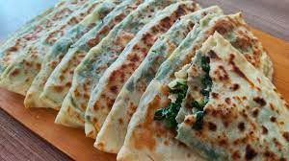
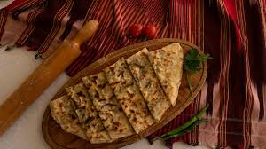
GOZLEME (TURKISH FLATBREAD)
Gozleme is a type of appetizer Turkish pastry prepared by filling thinly rolled dough with various fillings and cooking it on a griddle over a wood fire.
"Kozmen," meaning bread baked on embers during the Seljuk period, is one of the first terms used to mean gozleme. Over time, with the evolution of spoken language and varying regional dialects, the name changed and became "gozleme."

Slide 22
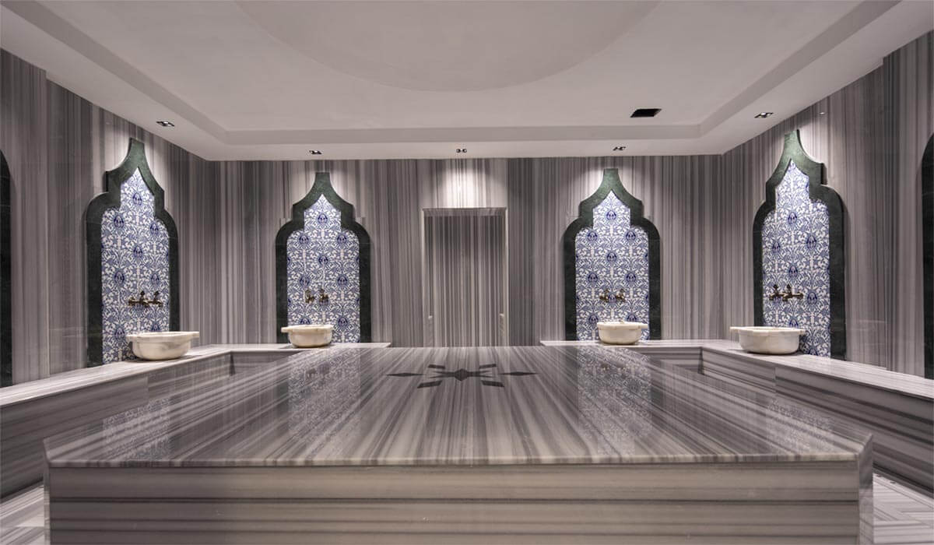
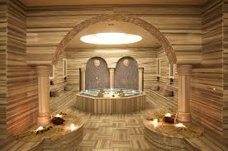
TURKISH BATH (HAMAM)
There has been a bath culture in Anatolia since very ancient times. When Turks lived in Central Asia, they carried their existing bath traditions to Anatolia where they migrated. They established their own traditions on top of the marble bath culture left by those who lived before them. Over time, baths became places where very special occasions were celebrated. Even today, traditions such as the "bridal bath," "postpartum bath," "baby's fortieth-day bath," "votive bath," and "mourning bath" for women, and the "groom's bath," "circumcision bath," "soldier's bath," and "holiday bath" for men continue to be observed.

Slide 23
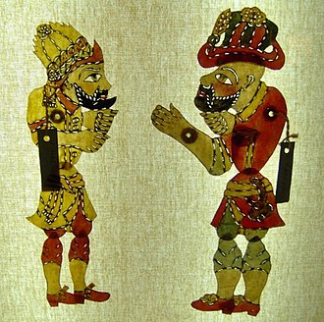
KARAGOZ AND HACIVAT
Karagoz and Hacivat is a shadow play performed on a screen with two-dimensional figures, based on imitation and dialogue. The puppeteer of Karagoz is called "hayali" (imaginary). In the play, changes in conversation are indicated by head movements.
It is not definitively known whether these two characters actually lived, and if so, where and how they lived. The accounts are based on legends, as even if they did live, they most likely were not considered important enough to be recorded in history books of that era.

Slide 24
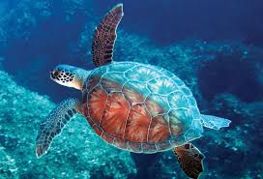
CULTURAL AND NATURAL HERITAGE SEA TURTLE
Caretta caretta, which never come ashore except to lay eggs, are in the category of endangered species. On Turkey's Mediterranean coasts, loggerhead sea turtles (Caretta caretta) and green sea turtles (Chelonia mydas) lay their eggs. According to the results of studies conducted in the Mediterranean from the past to the present, the most important nesting areas for the Caretta caretta species are Turkey and Greece.

Slide 25
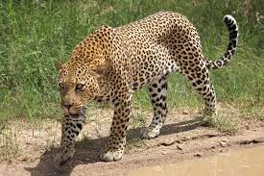
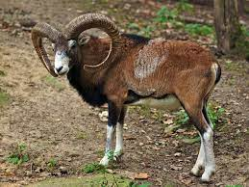
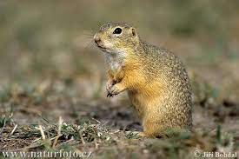
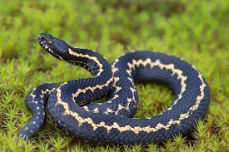
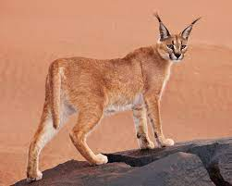
ENDEMIC ANIMAL SPECIES
SEA TURTLE
Caretta Caretta
ANATOLIAN LEOPARD
Pantera pardus tuttiana
ANATOLIAN MOUFLON
Ovis orientalis anatolica
GROUND SQUIRREL
Citellus citellus
HOPA VIPER
Vipena kaznakovi
STEPPE CARACAL
Felis caraca

Slide 26
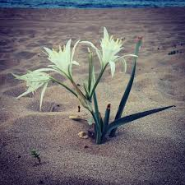
CULTURAL AND NATURAL HERITAGE SEA DAFFODIL (Pancratium maritimum)
The sea daffodil belongs to the Amaryllidaceae family and is a perennial, bulbous plant species that grows particularly on Mediterranean sand dunes. Its homeland is the Mediterranean region. It is an endemic plant species. In our country, criminal sanctions are applied to those who damage this plant.
Sea daffodils are generally found in areas a few meters from the sea. Their spear-like leaves emerging from the base can reach 40 cm in length and are not shed in winter. The flowering period is between August and October.

Slide 27





ENDEMIC PLANT SPECIES
SEA DAFFODIL
Pancratium maritimum
TAURUS ORCHID
Himantoglossum Montis-tauri
BAYTOP CROCUS
Colchicum Baytopiorum
PHASELIS VETCH
Lathyrus Phalitanus
SIDE BROOMRAPE
Orobanche Sideana
PERGE ALKANET
Alkanra Macrophilla

Slide 28
IMPORTANT NOTICES WHEN VISITING LOCAL, HISTORICAL, ARCHAEOLOGICAL, CULTURAL, AND SPIRITUAL SITES
Please do not participate in tourist activities that involve animal exploitation.
Please be environmentally conscious in tour areas.
In our country, cigarettes and alcoholic beverages are not sold to children under 18 years of age.
Do not photograph or touch children without permission from their families.
Before entering sacred places like mosques, shoes are removed and women cover their hair with a scarf.

Slide 29





FOR OUR ENVIRONMENT;
Dear Guests,
Choosing products that do not harm nature when selecting sprays, deodorants, perfumes, sunscreens, and insect repellents for your personal care is the best investment for a sustainable environment.
If a sunscreen contains any of the following ingredients, look for a marine-life-safe alternative: Oxybenzone, Benzophenone-1, Benzophenone-8, OD-PABA, 4-Methylbenzylidene Camphor, 3-Benzylidene Camphor, nano-Titanium Dioxide, nano-Zinc Oxide, Octinoxate, Octocrylene.

Slide 30


WHAT CAN WE DO TO PROTECT OUR ENVIRONMENT?
CONSUME LESS ELECTRICITY Turn off and unplug unnecessarily running devices.
RESEARCH Find out where or how a food you eat is produced.
CHANGE YOUR HABITS Use cloth bags instead of plastic bags.
NOTICE Put out a bowl of water for stray animals.
CONSUME LESS WATER Do not leave the water running while brushing your teeth or washing your hands.
OBSERVE Identify disposable items and use them less.
RENEW Try to repair broken or damaged items before replacing them with new ones.
DON'T USE Do not use single-use plastic straws.
RESPECT NATURE Use less paper, use both sides of the paper.
RECYCLE Dispose of your waste in the appropriate recycling bins.
PLANT A SAPLING Germinate a tree seed and plant your grown sapling in the soil.
SHARE Share clothes you no longer use with others.

Slide 31


HUMAN RESOURCES
% 69
% 31
% 72
% 28
% 0
% 100
ILLITERATE 1
HIGH SCHOOL 147
PRIMARY SCHOOL 75
BACHELOR'S 40
MIDDLE SCHOOL 50
MASTER'S 1

Slide 32







BENEFITS PROVIDED TO STAFF
Staff Housing:
Housing is allocated to our staff. The housing facilities provide amenities for personal needs.
Staff Shuttle Service:
Shuttle transportation to the hotel is provided for our staff.
Healthcare Services:
Our employees can receive healthcare services from the doctor's office at our hotel during working hours.
Meal Service:
Meals are served at all meal times in the staff canteen for our employees.
Laundry Service:
All our employees' uniforms are washed at our hotel. Those staying in housing can use the washing machine available in the housing.
English Lessons:
English lessons are provided to our staff in winter at our hotel by a research assistant from Alanya Keykubat University.

Slide 33





ENERGY SAVING
90% LED lights are used for lighting in our facility. Our target is 95% LED lighting.
All rooms have a switch system that disables heating/cooling devices when the balcony door is opened.
We prefer highly energy-efficient, locally sourced, eco-friendly devices and technologies. Our goal is to increase this ratio.
Motion-sensitive sensors are used in common areas and staff areas.
Common areas are designed to utilize daylight for energy savings.

Slide 34
ENERGY SAVING
Our outdoor lighting and some cooling systems are controlled by timers.
Electronic energy key cards are used in all rooms.
LED televisions are used in common areas and our rooms. Mini bars are positioned away from heat sources for energy savings.
Our rooms have blackout curtains. Curtains in empty rooms are kept closed in summer and open in winter to reduce HVAC usage.
Periodic maintenance and cleaning of all electronic devices is performed to minimize energy losses.

Slide 35
ENERGY SAVING
We have solar panels to utilize solar energy. We achieve 60% energy savings in the water heating system.
The seals of cold rooms, deep freezers, ice machines, and refrigerators are checked, and worn ones are replaced to prevent energy losses.
Dishwashers, washing machines, and dryers are not operated without being fully loaded.
All our energy consumption is recorded and monitored on a monthly and annual basis.
Our staff is trained on saving measures, and our guests are informed about our conservation practices.

Slide 36
ENERGY SAVING
In 2025, compared to 2024, our electricity consumption decreased by 15.28%, and per capita electricity usage decreased by 34.21%. These reduction rates are due to the saving measures implemented at our facility.

Slide 37
ENERGY SAVING
In 2025, a 38.56% saving was achieved in LNG (natural gas) usage compared to 2024.

Slide 38




WATER SAVING
Water-saving aerators are installed in all rooms and common areas.
Water-saving dual flush systems of 6 and 3 liters are used in all toilets.
Water savings are achieved by preferring shower cabins instead of bathtubs.
Drip irrigation and sprinkler systems are used in our garden to prevent water losses.

Slide 39


WATER SAVING
Our employees are trained on water conservation. Our guests are informed about our saving practices.
Wastewater is connected to the sewage system in accordance with discharge regulations.
Sensor-activated faucets and sensor urinals are used in all common areas. Our goal is to use sensor faucets in all areas.
Knee-operated timed systems are used in production areas.
Our water consumption is monitored and recorded on a monthly and annual basis.

Slide 40
WATER SAVING
In 2024, our per capita water consumption was 0.52 liters, while in 2025 it was 0.43 liters. Approximately 20% savings were achieved in water consumption.

Slide 41






WASTE MANAGEMENT
We separate our waste at the source.
We protect our resources by mostly using reusable materials instead of disposable ones.
To reduce paper consumption, we conduct correspondence via email and use paper on both sides.
We encourage our guests and employees to participate in recycling programs.
We reduce packaging waste by purchasing bulk-packaged and concentrated products.

Slide 42
WASTE MANAGEMENT
In 2024, the per capita solid waste amount was measured as 0.64 kg, while in 2025 it was 0.23 kg, representing approximately a 3-fold decrease.

Slide 43

OUR CERTIFICATES
We have been fulfilling Blue Flag requirements since 2022 and renewing our certificate every year.

Slide 44

OUR CERTIFICATES
We have been fulfilling the Zero Waste Regulation requirements since 2022.

Slide 45

OUR CERTIFICATES
Our Sustainable Tourism Phase 3 Certificate

Slide 46


Slide 47


Slide 48





SOCIAL RESPONSIBILITY
SUPPORT FOR THE BOTTLE CAP COLLECTION PROJECT OF THE TURKEY SPINAL CORD PARALYSIS ASSOCIATION
We have been supporting the Bottle Cap Collection Project of the Turkey Spinal Cord Paralysis Association since 2021, together with our team members and guests.

Slide 49


SOCIAL RESPONSIBILITY
As Aria Resort Hotel, we donate saplings every year.

Slide 50



SOCIAL RESPONSIBILITY

Slide 51


SOCIAL RESPONSIBILITY

Slide 52




SOCIAL RESPONSIBILITY
If you would like to contribute to our nature and endangered species, you can make a donation by scanning the QR codes.

Slide 53




SUPPORT FOR WILDLIFE
Nesting sites for Caretta caretta turtles that lay eggs on our beach are fenced off and necessary precautions are taken. Relevant warnings are provided to guests. Additionally, we have cat houses for our dogs and cats visiting our facility.
Caretta caretta egg-laying date: 16.06.2025

Slide 54



SUPPORT FOR WILDLIFE
Our facility has many fruit trees including avocado, guava, orange, banana, lemon, etc., and the fruits are served to our guests at the buffet. Additionally, information about all plant species is available.

Slide 55


SUPPORT FOR WILDLIFE
Some of the olives we serve to our guests at the buffet are harvested from the trees in our olive grove, and the olive oil we use is produced from these olives.

Slide 56






EXPERIENCING LOCAL CULTURE
All special flavors of our country and especially Alanya are offered to our guests at the buffet.
Additionally, Turkish Cuisine Culture is introduced to our guests at the "Turkish Night" organized one day a week at our hotel.

Slide 57
OUR TRAININGS
Some of the trainings we conduct with our staff:
SUSTAINABILITY / ENVIRONMENTAL TRAINING
HYGIENE TRAINING
OCCUPATIONAL SAFETY & HEALTH TRAINING
FIRE TRAINING & FIRE DRILL
CHEMICAL USAGE TRAINING
WORKING AT HEIGHTS TRAINING
FIRST AID TRAINING
FOOD SAFETY TRAININGS
COMMUNICATION WITH DISADVANTAGED GROUPS TRAINING
ANTI-ABUSE TRAINING
FAMILY LIFE SKILLS, STRESS MANAGEMENT TRAINING
ZERO WASTE & WASTE MANAGEMENT TRAINING
ENERGY SAVING TRAINING
ORIENTATION TRAINING
HOSPITALITY TRAINING
FOREIGN LANGUAGE (ENGLISH) TRAINING
ON-THE-JOB TRAININGS

Slide 58


OUR TRAININGS
FIRE TRAINING & FIRE DRILL 16.04.2025
ANTI-ABUSE TRAINING 08.04.2025

Slide 59


OUR TRAININGS
HAZARDOUS MATERIAL SAFETY TRAINING 02.07.2025
ZERO WASTE & WASTE MANAGEMENT TRAINING 05.04.2025

Slide 60


OUR MINI CLUB ACTIVITIES
To develop environmental awareness in our young guests, the importance of the environment and oceans is explained and related activities are organized. Additionally, drawings made by our young guests are exhibited in the hotel's meeting hall.

Slide 61


OUR SOCIAL CONTRIBUTIONS
As Aria Resort Hotel, we support women entrepreneurs. Products made by women entrepreneurs are displayed in the lobby area of our hotel, and all revenue from sales is passed on to them.
Souvenirs decorated with Alanya-specific illuminated gourds and Alanya visuals are also displayed in the same area.
Our Cultural Heritage

Slide 62




OUR EVENTS
Staff birthday celebrations

Slide 63


OUR EVENTS
Our beach cleaning events

Slide 64


OUR EVENTS
March 8 International Women's Day Event
08.03.2025

Slide 65



OUR EVENTS
Our season closing event
01.11.2025

